Slide 1
Chapter 6 Process Synchronization

Slide 2
Outline
Background
The Critical-Section Problem
Peterson’s Solution
Hardware Support for Synchronization
Mutex Locks
Semaphores
Monitors
Liveness
Evaluation

Slide 3
Background
Example: the producer-consumer problem
Producer produces items
Consumer consumes items
The buffer, in, out and counter are shared between producer/consumer
Producer and consumer may be processes
Buffer, in, out, and counter are in their shared memory (IPC)
Or Producer and consumer may be threads in the same process
Buffer, in, out, and counter are global variables

Slide 4
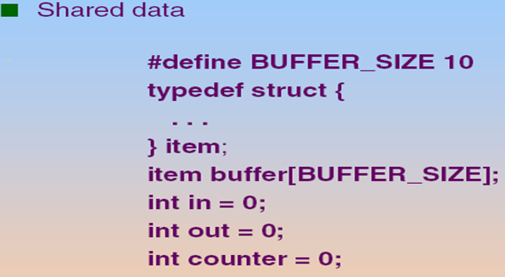
Bounded Buffer
out
counter = 4
in

Slide 5
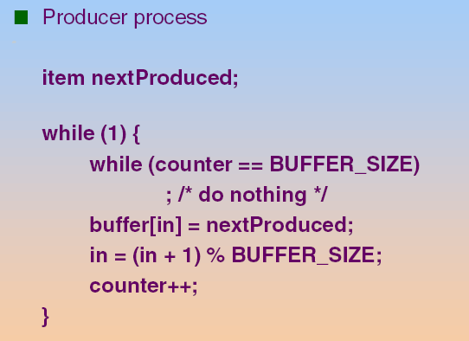
Producer Process/Thread

Slide 6
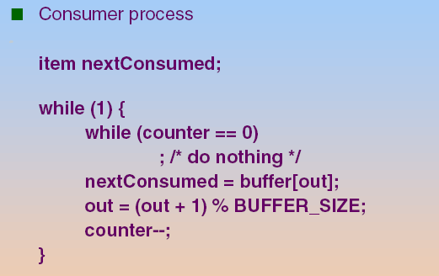
Consumer Process/Thread

Slide 7
Race Conditions
The “counter++” and “counter--” is compiled to a sequential of CPU instructions
Then, these CPU instructions are executed in some arbitrary order.
As shown in the following slide
“counter++” is compiled as
“counter--” is compiled as
mov eax, counter
inc eax
mov counter, eax
mov ebx, counter
dec ebx
mov counter, ebx

Slide 8
Race Conditions (Cont.)
Assume that initially counter = 5
Producer Thread | Consumer Thread | eax (in CPU) | ebx (in CPU) | counter | eax_P (in P’s PCB) | ebx_C (in C’s PCB)
mov eax, counter | --- | 5 |  | 5
inc eax | --- | 6 |  | 5
--- | mov ebx, counter |  | 5 | 5 | 6
--- | dec ebx |  | 4 | 5 | 6
mov counter, eax | --- | 6 |  | 6 |  | 4
--- | mov counter, ebx |  | 4 | 4

Slide 9
Summary: Concurrent access to shared data may result in data inconsistency

Slide 10
Background (Cont.)
Race condition:
Several processes concurrently access and manipulate the shared data
Outcome relies on the particular order in which the access takes place
Sol.: Process synchronization and coordination
Ensure only one process at a time can manipulate the shared data

Slide 11
Outline
Background
The Critical-Section Problem
Peterson’s Solution
Hardware Support for Synchronization
Mutex Locks
Semaphores
Monitors
Liveness
Evaluation

Slide 12
The Critical Section Problem
n processes all competing to use some shared data
Each process has a code segment in which the shared data is accessed.
This segment is called a critical section (CS)
See the following slide
Goal
When one process is executing in its critical section
No other processes are executing in their critical sections at the same time

Slide 13
Critical Section Example
Critical Section

Slide 14
The Critical Section Problem (Cont.)
To accomplish the goal, we need to modify the original code.
Before the CS, each process requests to use the critical sections exclusively: entry section
After the CS, each process releases the request: exit section
The remaining code is the remainder section

Slide 15
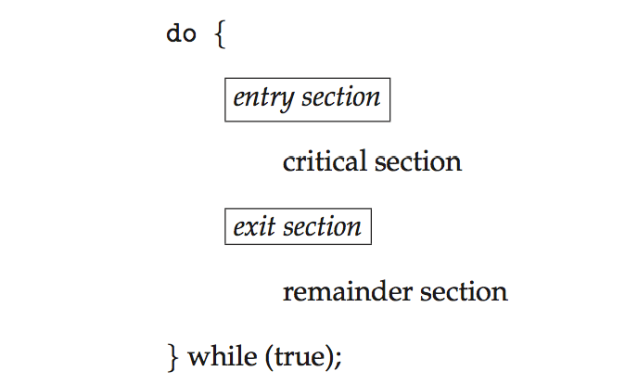
General Structure of a Typical Process
New Code
New Code
General structure of process P_{i}

Slide 16
問題：如何撰寫這兩段程式碼？

Slide 17
Solution to Critical-Section Problem
A solution should satisfy the following requirements
1. Mutual Exclusion
At any time, at most one process can be in its critical section (CS)
2. Progress:
If no process is executing in its CS and there exist some processes that wish to enter their CS…
Only those processes that are not executing in their remainder sections (i.e., in entry- or exit-sections) can participate in deciding which process will enter its critical section next (不相干者不參與決策)
And the selection of the processes that will enter the critical section next cannot be postponed indefinitely.
3. Bounded Waiting
After a process has made a request to enter its CS and before that request is granted
A bound must exist on the number of times that other processes are allowed to enter its critical sections
Guarantee the process will be selected to enter its CS
Otherwise the process will suffer from starvation

Slide 18
Solutions to Race Conditions
Software solutions
Peterson’s solutions
Hardware solutions
Rely on some special machine instructions
Operation System solutions
Provide some functions and data structures to the programmer
Built upon the hardware solutions

Slide 19
Outline
Background
The Critical-Section Problem
Peterson’s Solution
Hardware Support for Synchronization
Mutex Locks
Semaphores
Monitors
Liveness
Evaluation

Slide 20
Peterson’s Solution
Not guaranteed to work on modern architectures!
Discussed later
Two processes solution
The two processes share two variables:
int turn;
Indicate whose turn it is to enter the critical section
Boolean flag[2]
Indicate if a process is ready to enter the critical section.
flag[i] = 1, implies that process P_{i} is ready to enter CS

Slide 21
Peterson’s Solution
do {
flag[i] = TRUE;
turn = j; // you first
while ( flag[j] && turn == j);
CRITICAL SECTION
flag[i] = FALSE; // exit
REMAINDER SECTION
} while (TRUE);
Entry Section
Exit Section

Slide 22
Peterson’s Algorithm Global View
Process P0:
Do {
flag[0]:=true;
// P0 wants in
turn:= 1;
// P0 gives a chance to P1
while
(flag[1]&&turn=1){};
CS
flag[0]:=false;
// P0 no longer wants in
RS
While (1);
Process P1:
Do {
flag[1]:=true;
// P1 wants in
turn:=0;
// P1 gives a chance to P0
while
(flag[0]&&turn=0){};
CS
flag[1]:=false;
// P1 no longer wants in
RS
While (1);

Slide 23
P0 | P1 | turn
flag[0]:=true; | ---
turn:= 1; | --- | 1
--- | flag[1]:=true;
 | turn:= 0; | 0
while(flag[1]&&turn=1){};
CS
 | while(flag[0]&&turn=0){};
CS
flag[0]:=false; ……
 | while(flag[0]&&turn=0){};
 | CS

Slide 24
Peterson’s Algorithm Global View
Question 1:
In P0(P1), why set turn to 1 (0)?
Hint: cannot guarantee some of the requirements of solutions to critical sections
(see the following slide!)
Question 2:
Is it possible to change the first two statements?
No! (see the following slide!)

Slide 25
Question 1 : In P0(P1), Why set turn to 1 (0)?
P0 | P1 | turn
flag[0]:=true; | ---
turn:= 0; | --- | 0
--- | flag[1]:=true;
 | turn:= 1; | 1
while(flag[1]&&turn=1){};
 | while(flag[0]&&turn=0){};
 | CS
 | flag[1]:=false; RS
 | // P1 wants to enter again flag[1]:=true; turn:= 1;
 | while(flag[0]&&turn=0){};
 | CS (violate bounded waiting)

Slide 26
Question 2 : Is it possible to change the first two statements?
P0 | P1
turn:= 1; | ---
--- | turn:= 0;
--- | flag[1]:=true;
 | while(flag[0]&&turn=0){};
 | CS
flag[0]:=true; | ---
while(flag[1]&&turn=1){}; | ---
CS

Slide 27
Proof of Correctness
Mutual exclusion is preserved since:
turn can only be 1 or 0 but cannot both
Progress
Suppose P0 wishes to enter CS
If flag[1]=false, P0 can enter
Otherwise, turn allows either P0 or P1 to enter
If turn == 0; P0 can enter
If turn == 1
Once P1 exits, it sets flag[1] to false, allows P0 to enter
If P1 continues execution and resets flag[1] to true, it must also set turn to 0, allow P0 to enter
Pi will enter critical section
Bounded waiting
Pi wants at most one entry of Pj

Slide 28
Drawbacks of Software Solutions
Prone to error if not careful
Not guarantee work on modern computer architecture
As shown later
A two processes solution
Processes that are requesting to enter in their critical sections are busy waiting
Consuming processor time

Slide 29
Not Guaranteed to Work on Modern Computer Architecture
Peterson’s Solution is not guaranteed to work on modern architectures.
In current computers, processors and/or compilers may reorder operations that have no dependencies to improve performance.
Thus, the statements in the Peterson’s solution may be reordered

Slide 30
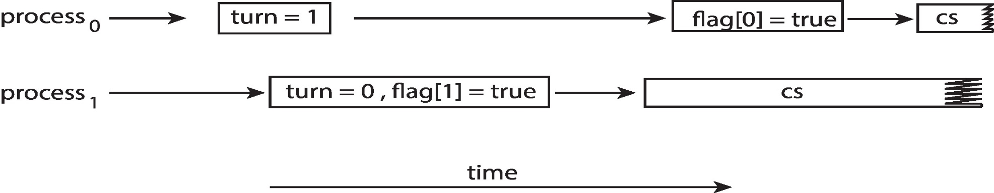
Peterson’s Solution in Current Computer Architecture
Example
Assume the first two statements in the entry section are reordered
Assume that P0 and P1 run on two different processors
It is possible that both processes are in their critical section at the same time!

Slide 31
Outline
Background
The Critical-Section Problem
Peterson’s Solution
Hardware Support for Synchronization
Mutex Locks
Semaphores
Monitors
Liveness
Evaluation

Slide 32
複習： Solutions to Race Conditions
Software solutions
Peterson’s solutions
Hardware solutions
Rely on some special machine instructions
Operation System solutions
Provide some functions and data structures to the programmer
Built upon the hardware solutions

Slide 33
Race Conditions (Cont.)
Assume that initially counter = 5
Producer Thread | Consumer Thread | eax (in CPU) | ebx (in CPU) | counter | eax_P (in P’s PCB) | ebx_C (in C’s PCB)
mov eax, counter | --- | 5 |  | 5
inc eax | --- | 6 |  | 5
--- | mov ebx, counter |  | 5 | 5 | 6
--- | dec ebx |  | 4 | 5 | 6
mov counter, eax | --- | 6 |  | 6 |  | 4
--- | mov counter, ebx |  | 4 | 4

Slide 34
Hardware Support for Synchronization
Now, many systems provide special hardware support for multi-processor systems
Three common forms of hardware support:
Memory barriers
Hardware instructions
Atomic variables

Slide 35
Outline
Background
The Critical-Section Problem
Peterson’s Solution
Hardware Support for Synchronization
Memory barriers
Hardware instructions
Atomic variables
Mutex Locks
Semaphores
Monitors
Liveness
Evaluation

Slide 36
Memory Barriers (Cont.)
Memory Barrier (屏障), or memory fences (籬笆) :
An instruction (mfence for x86) that enforce an ordering constraint on memory operations issued before and after the barrier instruction
Operations issued prior to the barrier are guaranteed to be performed before operations issued after the barrier.
In fact, it is when a memory barrier instruction is performed, all loads and stores are completed before any subsequent load or store operations are performed (SKIP!)
Disable out-of-order execution (reordering) of CPUs

Slide 37
複習： Peterson’s Solution in Current Computer Architecture
Example
Assume the first two statements in the entry section are reordered
Assume that P0 and P1 run on two different processors
It is possible that both processes are in their critical section at the same time!

Slide 38
Using Memory Barriers for Peterson’s Solution
Place a memory barrier between the first two statements
flag[i] = TRUE;
memory_barrier();
turn = j;

Slide 39
Memory Barriers
But, there are still other problems with Peterson’s solution.
See the following slide
Using memory barriers is not enough
Besides, memory barriers is low-level operations
Only adopted by kernel developers
Not friendly to user application programmers

Slide 40
複習：Drawbacks of Software Solutions
Prone to error if not careful
Not guarantee work on modern computer architecture
As shown later
A two processes solution
Processes that are requesting to enter in their critical sections are busy waiting
Consuming processor time

Slide 41
Outline
Background
The Critical-Section Problem
Peterson’s Solution
Hardware Support for Synchronization
Memory barriers
Hardware instructions
Atomic variables
Mutex Locks
Semaphores
Monitors
Liveness
Evaluation

Slide 42
How to Provide Synchronization Tools by Hardware?

Slide 43
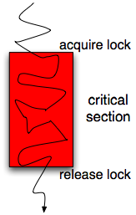
General Idea
Best mainstream solution: Locks
Implement “mutual exclusion”
when lock = 0, set lock = 1, and enter critical section
lock = 0

Slide 44
General Idea (Cont.)
But, you cannot update the lock by yourself
i.e., you cannot implement the following code by yourself
Why? Lock is also a shared variable
while (lock != 0) ;
lock = 1;
CS
lock = 0;
Assume that “lock = 1” is compiled as
mov eax, 1
mov lock, eax

Slide 45
Race Condition (Skip!)
Assume that initially lock = 0
Thread 1 | eax | Thread 2 | eax | lock
while (lock != 0); |  | --- |  | 0
mov eax, 1 | 1 | --- |  | 0
--- | --- | while (lock != 0); |  | 0
 |  | mov eax, 1 | 1
mov lock, eax | 1 |  |  | 1
CS
--- | --- | mov lock, eax |  | 1
 |  | CS

Slide 46
General Idea (Cont.)
Thus, accessing lock must be synchronized and protected
存取lock本身也是一個critical section
Sol.: atomic hardware instructions
test_and_set
compare_and_swap

Slide 47
Atomic Instructions
Modern CPUs provide special atomic instructions even in MP systems
Atomic: non-interrupted
If two atomic instructions are executed simultaneously (each on a different core)
They will be executed sequentially in some arbitrary order

Slide 48
test_and_set Instruction
Definition:
boolean test_and_set (boolean *target)
{
boolean rv = *target;
*target = TRUE;
return rv:
}
Done by a single instruction
Executed atomically
Returns the original value of passed parameter
Set the new value of passed parameter to true

Slide 49
Mutual-Exclusion using test_and_set
A shared Boolean variable lock, initialized to false:
Process P_{i}
do {
while (test_and_set(lock)) ;
critical section
lock = false;
remainder section
}

Slide 50
lock = false
busy waiting
Thread//Process 1 | Thread//Process 2
rv = FALSE, *target(=LOCK)=TRUE, return FALSE | ---
Enter CS, but soon context switch
--- | rv = TRUE, *target (=LOCK)= TRUE, return TRUE
--- | rv = TRUE, *target (=LOCK)= TRUE, return TRUE
--- | rv = TRUE, *target (=LOCK)= TRUE, return TRUE
Exit CRITICAL SECTION | ---
LOCK=FALSE
 | rv = FALSE, *target(=LOCK)=TRUE, return FALSE
 | Enter CRITICAL SECTION

Slide 51
compare_and_swap Instruction
Definition.
void compare_and_swap(int *value, int expected, int new_value)
{
int temp = *value;
if (*value == expected)
*value = new_value;
return temp;
}
Done by a single instruction
If the value matches “expected”, write “new_value” into value! Finally, return value

Slide 52
Mutual-Exclusion using compare_and_swap
Shared Boolean variable lock initialized to 0
Process P_{i}
do { while (compare_and_swap(&lock, 0, 1) != 0)
; /* do nothing */
/* critical section */
lock = 0;
/* remainder section */
} while (true);

Slide 53
lock = 0
Thread/Process 0 | Thread/Process 1 | Thread/Process 2
compare_and_swap()return 0
while ()不成立
CRITICAL SECTION
 | Remainder Section
--- |  | compare_and_swap()return 1
 |  | while ()成立
 |  | compare_and_swap()return 1
 |  | while ()成立……
CRITICAL SECTION
…… |  | ……
busy waiting

Slide 54
Bounded-Waiting with test_and_set()
Previous two versions only guarantees mutual exclusion
But do not satisfy bounded-waiting
Pi can enter CS repeatedly
As shown in the next page
Solution: in addition to lock, add another DS waiting[n]
boolean waiting[n];
waiting[i]=1; Pi wait to enter CS
Initialized to false
boolean lock;

Slide 55
lock = 0
Thread/Process 0 | Thread/Process 1 | Thread/Process 2
lock = TRUE, while ()不成立 |  | ---
CRITICAL SECTION
 | Remainder Section
--- |  | lock = TRUE, while ()成立
--- |  | lock = TRUE, while ()成立
 |  | lock = TRUE, while ()成立
CRITICAL SECTION
LOCK = FALSE
Remainder Section;
lock = TRUE, while ()不成立
Enter CRITICAL SECTION Again
 |  | lock = TRUE, while ()成立
 |  | lock = TRUE, while ()成立
 |  | lock = TRUE, while ()成立

Slide 56
Shared Boolean variable lock and wait[i] are initialized to FALSE
Do {
waiting[i] = TRUE; // P_{i} wish to enter CS
while (waiting[i] && TestandSet(&lock)) // if waiting[i]=false || lock=false
; // => escape the loop
waiting[i] = FALSE; // P_{i} enters CS
// critical section
j = (i+1)%n; // scan from i+1, i+2, …,n-1, 0, …i-1
while ( (j!= i) && waiting[j] == FALSE) // scan wait[j]
j = (j+1)%n; // select wait[j] = true to enter CS
if ( j == i ) lock = FALSE; // nobody wants to enter CS (as usual)
else waiting[j] = FALSE; // select wait[j] = false to enter CS
// remainder section
} while (TRUE);

Slide 57
lock = false, waiting[0]=false, waiting[1]=false, waiting[2]=false
Thread 0 | Thread 1 | Thread 2
waiting[0]=True | ---
(TetAndSet)return False, Lock=True | ---
waiting[0]=False | ---
CRITICAL SECTION
 | Remainder Section
 |  | waiting[2]=True
 |  | (TetAndSet)return True, Lock=True…
CRITICAL SECTION
j=1; while()成立; j=j+1(=2)
j=2; while()不成立; (waiting[2]=True) 跳開while()迴圈
if 不成立; 執行else waiting[2]=False
REMAINDER SECTION
waiting[0]=True
(TetAndSet)return True,Lock=True… (Cannot Enter Critical Section Again)
 |  | while()不成立(waiting[2]=False)
 |  | waiting[2]=False
 |  | Enter CRITICAL SECTION

Slide 58
Proof: Bounded-Waiting with test_and_set() (Cont.) (Skip!)
Mutual Exclusion: Pi can enter CS only if either waiting[i]==false or test_and_set()==false
waiting[i] becomes false only if one process leaves CS
Only one waiting[i] is set to false
Progress: similar to mutual exclusion
A process exiting CS either set lock to 0 or set waiting[j] for false. Both allows a process to enter its CS
Bounded waiting: waiting in the cyclic order
Guarantee bound-waiting

Slide 59
However, Using test-and-set and compare-and-swap is Still Not Easy for Programmers!

Slide 60
Outline
Background
The Critical-Section Problem
Peterson’s Solution
Hardware Support for Synchronization
Memory barriers
Hardware instructions
Atomic variables
Mutex Locks
Semaphores
Monitors
Liveness
Evaluation

Slide 61
Atomic Variables
Instructions such as compare-and-swap and test-and-set are used as building blocks for other synchronization tools.
One tool is an atomic variable
Provides atomic (uninterruptable) updates on basic data types (e.g., integers and booleans).

Slide 62
Atomic Variables (Cont.)
Ex 1: x86 provides a “lock” prefix
Tells the hardware: “don’t let anyone read/write the value until I’m done with it”
See the following slide
Ex 2: Some high level language, e.g., C++ and Java, also support atomic variables
Provides special atomic data types + special functions for accessing atomic variables
These functions are implemented using compare-and-swap or test-and-set (see the following slide)
For example, the increment() operation on an atomic variable counter
counter is incremented without race condition
increment(&counter);

Slide 63
Example: Intel Lock Prefix
static inline int fetch_and_add(int* variable, int value)
{
__asm__volatile("lock; xaddl %0, %1"
: "+r"(value), "+m"(*variable) // input+output :
: // No input-only :
: "memory"
);
return value;
}
Adding lock prefix makes “xaddl” instruction executed atomically

Slide 64
Atomic Variables (Cont.)
void increment(atomic_int *v) { int temp; do { temp = *v; } while (temp != (compare_and_swap(v,temp,temp+1)); }
Implementation of increment() operation

Slide 65
Example: without Atomic Variables (Skip!)
Assume two threads executes “counter++”
Assume initially counter = 5; (The result should be 7, but 6)
Thread 1 | eax | Thread 2 | eax | counter
mov eax, counter | 5 | --- |  | 5
inc eax | 6 | --- |  | 5
--- | --- | mov eax, counter | 5 | 5
--- | --- | inc eax | 6 | 5
mov counter, eax | 6 | --- |  | 6
--- | --- | mov counter, eax |  | 6

Slide 66
Example: with Atomic Variables (Skip!) *counter = 5, calling increment(), the result is 7
Thread 1 | Thread 2
temp = *v (=counter) = 5 | ---
--- | temp = *v (=counter) = 5
--- | compare_and_swap(v, temp, temp+1); // *v (=counter) = temp+1 = 6; return 5
compare_and_swap(v(=6), temp(=5), temp+1); // *v != temp, v = 6, return 6;
temp != 6; while()成立 (busy waiting)
temp = *v (=counter) = 6
 | temp == 5; while ()不成立
 | increment() 完成 Continue to the following instruction
compare_and_swap(v, temp, temp+1); // *v (=counter) = temp+1=7, return 6;
temp == 6; while ()不成立
increment() 完成 Continue to the following instruction

Slide 67
Atomic Variables (Cont.)
But, atomic variables do not entirely solve CS problems
Only do a limited set of operations to basic data type
Not enough to synthesize more complicated operations
Example
Consider a red-black tree shared by multiple processes/threads.

Slide 68
Outline
Background
The Critical-Section Problem
Peterson’s Solution
Hardware Support for Synchronization
OS Solution: Mutex Locks
Spin Locks
Semaphores
Monitors
Liveness
Evaluation

Slide 69
Problems in Previous Approaches
Previous hardware-based solutions are complicated or not enough to application programmers
Memory barriers
Hardware instructions
Atomic variables
Solution: OS build a more convenient approach to solve critical section problem
mutex locks, spin lock, semaphores

Slide 70
Mutex Locks
Mutex (mutual exclusion) lock : a synchronization tool provided by OS
mutex : a boolean variable
Can only be accessed via two atomic (indivisible) system calls:
acquire() and release()

Slide 71
複習：General Idea
Best mainstream solution: Locks
Implement “mutual exclusion”
when lock = 1, set lock = 0, and enter critical section
lock = 1

Slide 72
Mutex Locks
acquire() { while ( mutex==false )
; /* busy wait */
mutex = false;;
}
release() {
mutex = true;
}

Slide 73
General Idea: Using Mutex Lock
Acquire mutex lock
Release mutex lock

Slide 74
Race Condition Problem Solved by mutex
For n processes, initialize mutex value to 1
Then only 1 process is allowed into CS
acquire(mutex);
// CS
release(mutex);
Remainder section

Slide 75
mutex = 1
Thread 0 | Thread 1
---
acquire() set mutex=false
CRITICAL SECTION
 | acquire()’s while() busy waiting
CRITICAL SECTION
release() set mutex=true
REMAINDER SECTION
 | acquire()’s while() break
 | CRITICAL SECTION
 | release() set mutex=true
 | REMAINDER SECTION

Slide 76
Since mutex is a shared variable, acquire() and release() must be atomically.
OS uses test-and-set or compare-and-swap to implement these functions

Slide 77
Outline
Background
The Critical-Section Problem
Peterson’s Solution
Hardware Support for Synchronization
OS Solution: Mutex Locks
OS Solution: Spin Locks
Semaphores
Monitors
Liveness
Evaluation

Slide 78
Spin Locks
Above mutex needs busy waiting
Another implementation scheme is to let the process/thread wait
Introduced later
But, busy waiting may be good in some cases

Slide 79
Spin Locks
Spinlock
“spin”(旋轉) while waiting the lock, i.e., busy waiting
Has one advantage: no context switch is required
Preferable choice in MP if critical section is short
No context switch overhead and can quickly obtain the lock
See the next slide

Slide 80
Spinlock Is Only Useful in MP Systems
mutex:1
0
release(M){
M=1; }
Acquire(M){
while(M==False)
;
M=0;
}
process A on processor 1
process B on processor 2
acquire(mutex);
// CS
release(mutex);
B=B+1;
A=A+1;
acquire(mutex);
// CS
release(mutex);
busy waiting

Slide 81
Spin Locks
Spinlock
例子：看漫畫，如果漫畫在他人手上(漫畫是shared variable)
1. Short:如果剩下兩頁：busy waiting, 否則: sleep
2. MP: 你和他都是processes/threads, running on two processors
(if single processor ，只要你等他就不看，因此，即使剩兩頁，但如果他不看，則busy waiting也沒有意義)

Slide 82
Outline
Background
The Critical-Section Problem
Peterson’s Solution
Hardware Support for Synchronization
Mutex Locks
Spin Locks
OS Solution: Semaphores
Semaphore Definition
Semaphore Usage
Semaphore Implementation
Monitors
Liveness
Evaluation

Slide 83
Semaphore
Semaphore: a more powerful synchronization tool (than mutex) provided by OS
Semaphore S – integer variable
Can only be accessed via two operations(system calls):
wait (S): {
while S ≤ 0
; // no-op S--; }
signal (S): {
S++;
}

Slide 84
Outline
Background
The Critical-Section Problem
Peterson’s Solution
Hardware Support for Synchronization
Mutex Locks
Spin Locks
Semaphores
Semaphore Definition
Semaphore Usage
Semaphore Implementation
Monitors
Liveness
Evaluation

Slide 85
Semaphore Types
Semaphore
Counting semaphore – unrestricted integer value
Control access to a given resource with N instances
Semaphore value is initialized to N
Binary semaphore – integer value can range only between 0 and 1;
Similar to mutex locks
Binary semaphore is initialized to 1

Slide 86
General Idea: Mutual-Exclusion with Binary Semaphores
Acquire semaphore
Release semaphore

Slide 87
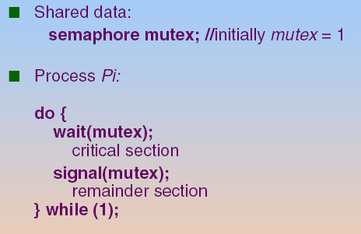
Mutual-Exclusion with Binary Semaphores
For n processes, initialize S value to 1
Then only 1 process is allowed into CS (mutual exclusion)

Slide 88
Mutual-Exclusion Implementation with Semaphores
wait(S) {
while S ≤ 0
; // no-op
S--; }
mutex:1
0
signal(S) {
S++;
}
process A
process B
process C
busy waiting
busy waiting
wait(mutex);
// CS
signal(mutex);
wait(mutex);
// CS
signal(mutex);
wait(mutex);
// CS
signal(mutex);

Slide 89
Using Semaphores to Synchronize Processes
Semaphore can also be used to solve synchronization problems.
Example:
Two processes: P1 and P2
Statement S1 in P1 needs to be performed before statement S2 in P2
synch is a semaphore and initialize synch to 0
P1:
S1;
signal(synch);
P2:
wait(synch);
S2;

Slide 90
Using Semaphores to Synchronize Processes
wait(S){
while S ≤ 0
; // no-op
S--; }
synch:0
process 1
process 2
S1;
signal(synch);
wait(synch);
S2;
busy waiting

Slide 91
Outline
Background
The Critical-Section Problem
Peterson’s Solution
Hardware Support for Synchronization
Mutex Locks
Spin Locks
Semaphores
Semaphore Definition
Semaphore Usage
Semaphore Implementation
Monitors
Liveness
Evaluation

Slide 92
Semaphore Implementation
But, above semaphore (and mutex) also needs busy waiting
To avoid busy waiting:
Put the process to wait, i.e., put in a waiting queue
Each semaphore is associated with a waiting queue
Re-define a semaphore as a record
typedef struct {
int value; struct PCB *L; } semaphore;

Slide 93
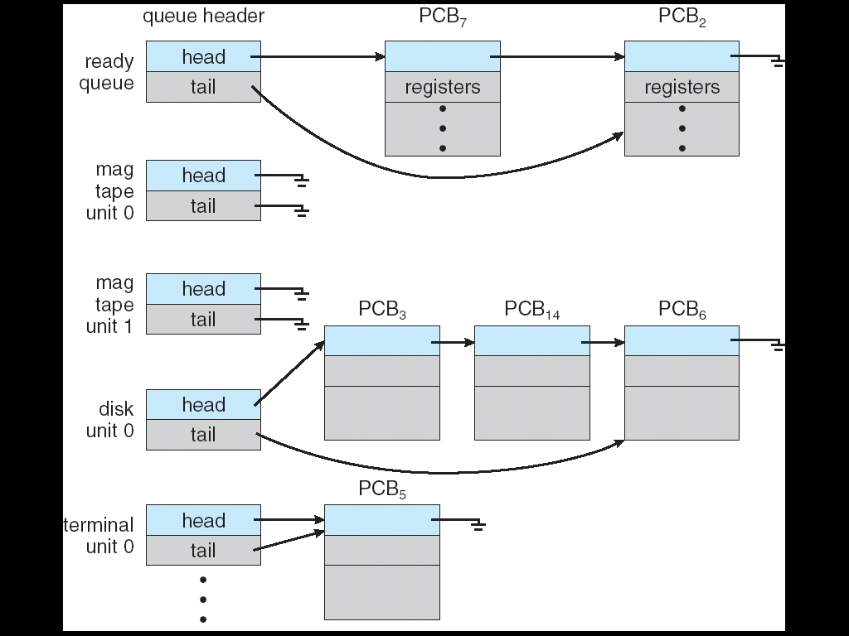
複習：Various Wait Queues
There may be a set of wait queues

Slide 94
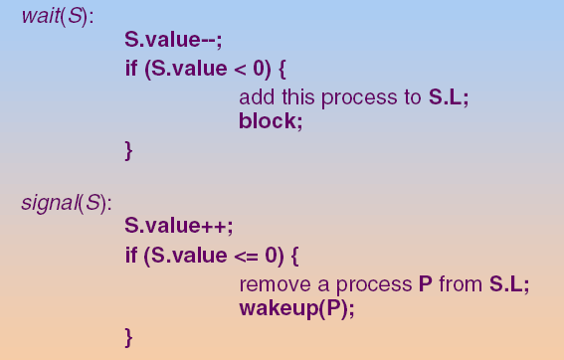
Semaphore Implementation (Cont.)

Slide 95
Mutual-Exclusion Implementation with the New Semaphores
wait (S) {
S.Value--;
if (S.Value < 0 )
Add process to S.L
}
singal (S) {
S.Value++;
if (S.Value <= 0)
Wake process from S.L
}
S.value: 1
0
-2
-1
S.L:
B
C
process A
process B
process C
blocked (waiting)
blocked (waiting)
wait(mutex);
// CS
signal(mutex);
wait(mutex);
// CS
signal(mutex);
wait(mutex);
// CS
signal(mutex);

Slide 96
OS 必須確保 no two processes can execute wait() and signal() on the same semaphore at the same time
OS會利用test_and_set或是compare_and_set確保上述條件成立

Slide 97
Outline
Background
The Critical-Section Problem
Peterson’s Solution
Hardware Support for Synchronization
Mutex Locks
Spin Locks
Semaphores
Language-Level Solution: Monitors
Liveness
Evaluation

Slide 98
Problems with Semaphores
Semaphores provide a convenient mechanism for process synchronization.
However, incorrect use may result in errors
Interchange the order of wait() and signal()
Violate the mutual exclusion
See the next slide
Replace signal() with wait()
Deadlock will occur
Omit wait() or signal()
Either mutual exclusion is violated or a deadlock will occur
The bugs are hard to detect
Faults don’t always take place
Solution: high-level language constructs like monitor

Slide 99
Problems with Semaphores
signal(mutex);
...
critical section
...
wait(mutex);
wait(mutex);
...
critical section
...
(a) incorrect order
(not mutual exclusive)
(c) forgotten
...
critical section
...
signal(mutex);
wait(mutex);
...
critical section
...
wait(mutex);
(b) typing error
(deadlock)

Slide 100
Outline
Background
The Critical-Section Problem
Peterson’s Solution
Hardware Support for Synchronization
Mutex Locks
Semaphores
Monitors
Monitor Usage
Implementing a Monitor Using Semaphore
Resuming Processes within a Monitor
Liveness
Evaluation

Slide 101
Monitor
A high-level abstraction that provides a convenient mechanism for process synchronization
Found in many programming languages
Concurrent Pascal, Modula-3, uC++, Java...
Monitor: encapsulate private data with public method
Variables can be accessed by only the local procedures
Only one process may be active within the monitor at a time
Using monitor incorrectly are still hard-to-be-detected bugs

Slide 102
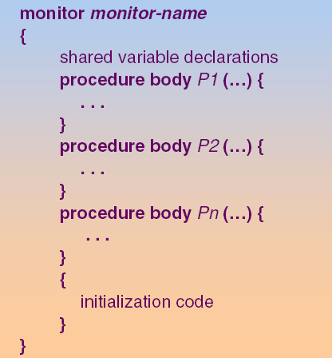
Monitor Structure

Slide 103
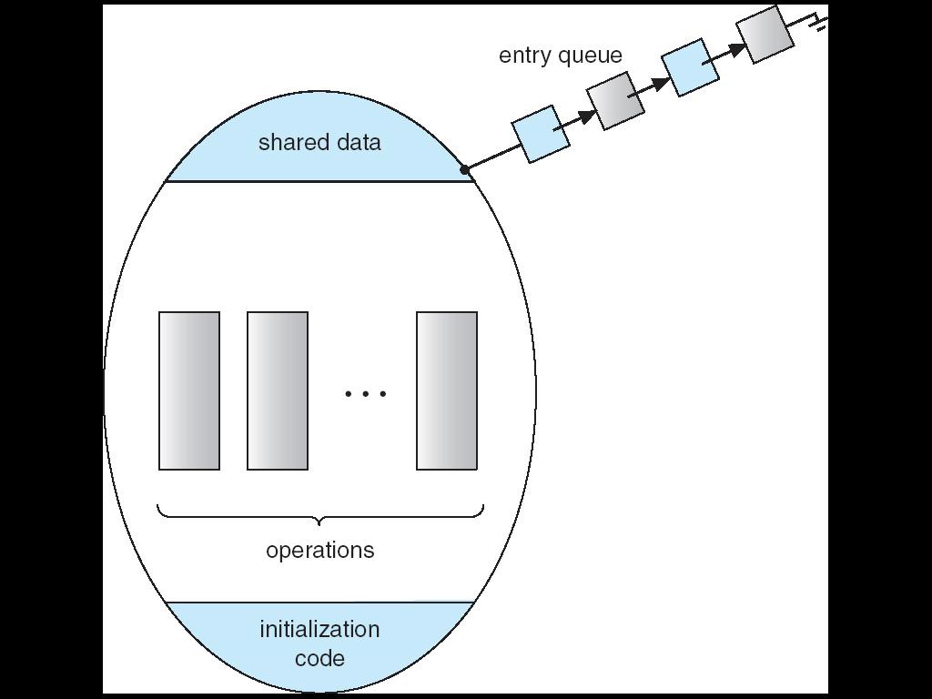
Schematic View of a Monitor

Slide 104
B
C
monitor entry queue:
blocked
blocked
process A
process B
process C
x = x + 1
demo.func1()
y = y – 1;
x1 = x1 - 1
demo.func2()
y1 = y1 + 1;
x2 = x2 - 1
demo.func2()
y2 = y2 + 1;
monitor Demo{
int counter;
counter = 0;
void func1() {
counter++;
}
void func2(){
counter--;
}
}

Slide 105
Monitor (Cont.)
With monitors, programmers do not need to code the synchronization constraint
However, previous monitor is function-limited
Example: a process within a monitor wants to be blocked until some conditions are satisfied
Sol. Condition Variable
To allow a process to wait within a monitor

Slide 106
Monitors with Condition Variables
condition x, y
Two operations on a condition variable x
x.wait()
Process invoking this operation is suspended
x.signal()
Resume one suspended process.
If no process is suspended, the signal operation has no effect.
Different from semaphore
signal() on a semaphore affects the state of the semaphore, i.e., add one

Slide 107
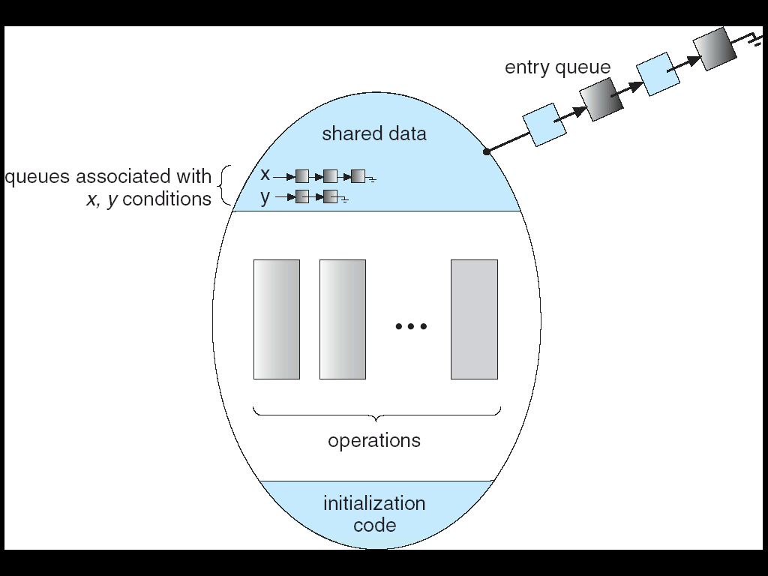
Monitor with Condition Variables
process may be
blocked in a monitor

Slide 108
B
C
monitor entry queue:
x.queue:
A
blocked
blocked
process A
process B
process C
x = x + 1
demo.func1()
y = y – 1;
x1 = x1 - 1
demo.func2()
y1 = y1 + 1;
x2 = x2 - 1
demo.func2()
y2 = y2 + 1;
monitor Demo{
int a;
condition x;
a = 0;
void func1() {
if (this.a == 0)
x.wait();
a++;
}
void func2()
x.signal();
}
blocked

Slide 109
Monitors with Condition Variables (Cont.)
Questions
If A executes x.wait() and is blocked
Then B executes x.signal() that wakes up A
Now, both B and A are active => one must wait.
Two possibilities for the implementation:
Signal and wait: B signals and waits
A is active in the monitor
B waits until A leaves the monitor
Signal and continue: B signals and continues
B is still active in the monitor
A waits until B leaves the monitor

Slide 110
Outline
Background
The Critical-Section Problem
Peterson’s Solution
Hardware Support for Synchronization
Mutex Locks
Semaphores
Monitors
Monitor Usage
Implementing a Monitor Using Semaphore
Resuming Processes within a Monitor
Liveness
Evaluation

Slide 111
Implement a Monitor Using Semaphores
There are three cases to be blocked in a monitor
Case 1: when entering a monitor
If another process is currently executed in the monitor
Case 2: when calling x.wait(), for each condition variable x
The calling process will be blocked
Case 3: When calling x.signal(), for each condition variable x
Assume that signal and wait
The calling process may wait until the resumed process to leave or wait

Slide 112
Implement a Monitor Using Semaphores (Cont.)
Thus, we need three kinds of semaphore
case 1: use a semaphore mutex (init. as 1) for each monitor
wait(mutex) before entering the monitor
signal(mutex) after leaving the monitor
case 2: each condition variable, x, is implemented by using
x_sem (init. as 0): semaphore corresponds to x
int x_count (init. as 0): number of processes waiting on x_sem
case 3: assume signal and wait, use another semaphore
next (init. as 0): used by a signaling process since it must wait
int next_count (init. as 0): number of processes suspend on next

Slide 113
Implement a Monitor Using Semaphores (Cont.)
Each external (public) procedure F will be replaced by
wakeup a
suspended process
in the monitor
(due to signaling)
wait(mutex);
body of F;
if next-count>0
signal(next);
else
signal(mutex);
compiler
body of F
allow other processes
to enter the monitor

Slide 114
x.wait() and x.signal() Invoke Library------x.wait() and x.signal() are implemented in library
x.wait()
{
x-count++; // a new process is to be blocked on x
if (next-count > 0) // wait up processes that are
signal(next); // suspended in monitor due to signaling operations
else // no process suspended within the monitor
signal(mutex); // allow other processes to enter the monitor
wait(x-sem); // blocked itself on x
x-count--; // wakeup by another process, x-count--;
}
x.signal()
{
if (x-count > 0) // there are processes blocked within the monitor, wake up one
{
next-count++; // the signaling process is blocked in next, assume signal and wait
signal(x-sem); // wait up processes blocked on x
wait(next); // the signaling process is blocked
next-count--; // wakeup by another process, next-count--;
}
}

Slide 115
在黑板寫下列變數的值
mutex = 1 , next = 0, next_count = 0, x_sem = 0, x_count = 0
B
C
monitor entry queue:
x.queue:
A
blocked
blocked
process A
process B
process C
x = x + 1
demo.func1()
y = y – 1;
x1 = x1 - 1
demo.func2()
y1 = y1 + 1;
x2 = x2 - 1
demo.func2()
y2 = y2 + 1;
monitor Demo{
int a;
condition x;
a = 0;
void func1() {
if (this.a == 0)
x.wait();
}
void func2()
x.signal();
}
blocked

Slide 116
Outline
Background
The Critical-Section Problem
Peterson’s Solution
Hardware Support for Synchronization
Mutex Locks
Semaphores
Monitors
Monitor Usage
Implementing a Monitor Using Semaphore
Resuming Processes within a Monitor
Liveness
Evaluation

Slide 117
Resuming Processes Within a Monitor
If several processes are suspended on condition x
x.signal() should resume which process
Solutions:
FCFS
Priority

Slide 118
Outline
Background
The Critical-Section Problem
Peterson’s Solution
Hardware Support for Synchronization
Mutex Locks
Semaphores
Monitors
Liveness
Evaluation

Slide 119
Liveness
Liveness:
A set of properties that a system must satisfy to ensure processes make progress.
Liveness failure (or liveness hazards (危險)):
Fail to satisfy the liveness property
Result in poor performance and responsiveness
Example
Indefinite waiting (e.g., starvation) is an example of a liveness failure
Deadlock
Priority Inversion

Slide 120
Deadlock
Deadlock – two or more processes are waiting indefinitely for an event that can be caused by only one of the waiting processes
Example: Let S and Q be two semaphores initialized to 1
P₀ P₁
wait (S); wait (Q);
wait (Q); wait (S);
. .
. .
signal (S); signal (Q);
signal (Q); signal (S);
Now, P₀ and P₁ are deadlocked.

Slide 121
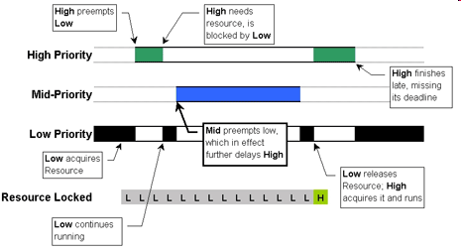
Priority Inversion

Slide 122
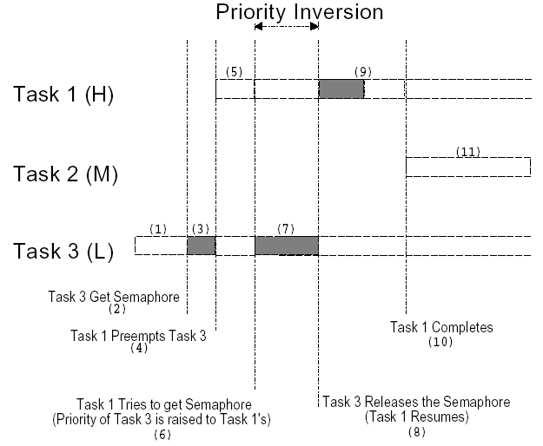
Solution: Priority Inheritance Protocol (PIP)

Slide 123
Outline
Background
The Critical-Section Problem
Peterson’s Solution
Hardware Support for Synchronization
Mutex Locks
Semaphores
Monitors
Liveness
Evaluation

Slide 124
Evaluation
Previously, we use compare-and-swap or test-and-set to implement lock-based (mutex, semaphore..) synchronization tools
Recently, a focus on using CAS to construct lock-free programming
Comparisons
Lock-based scheme: an pessimistic scheme
先取得Lock，不管會不會發生race condition
lock-free programming: an optimistic scheme
先執行，如果之後有問題(發生conflict)，則重新執行！

Slide 125
Lock-Free Programming Example (Skip!)
For (;;)
{
// Copy a shared variable (m_Head) to a local variable (oldHead).
oldHead = m_Head;
// Do the modification locally via newHead, thus, not yet visible to other threads
newHead = m_Head;
newHead->next = oldHead;
// Next, attempt to publish our changes to the shared variable.
// If the shared variable hasn't changed, the CAS succeeds and we return.
// Otherwise, repeat.
if(compare_and_swap(&m_Head, oldHead, newHead)==oldHead)
return;
}

Slide 126
Detailed Comparisons (Skip!)
Thus, depend on contention loads
Uncontended: lock-free programming is better
Moderate contention: lock-free programming is better
In traditional synchronization scheme, any attempt to acquire a contended lock result in a more complicated and time-consuming code path
Suspend a thread, place it on a wait queue, and context switch to another thread
High contention: traditional synchronization methods will be faster

Slide 127
Evaluation
Besides: when to use which synchronization tool?
Atomic variables are much lighter than mutex or semaphores for single updates to shared simple variables, e.g., integers
Spinlock are used on MP if CS is short
Mutex locks are simpler and less overhead than (binary) semaphores
Nevertheless, if controlling access to a number of resources, counter semaphore is more appropriate than a mutex lock
Read-writer locks are preferred over a mutex lock since it allows a higher degree of concurrency (introduced in Chapter 7)
Monitor and condition variables may have significant overhead and cannot scale well in highly contended (競爭) situations

